Slide 1
AFT Local 6262 Part-time Faculty United at COC
Follow us on:
Twitter: @AFTLocal6262
Facebook Group: AFT Local 6262
Website: www.aftcoc.org

Slide 2
Union Strong!
When we went on strike, we told you that we expected significant positive outcomes, and that tangible results would be felt at the bargaining table.
We achieved our goals!

Slide 3
Final Agreements
Article 1: Term of Contract (2022-24)
Article 4: Increased Release Time
Article 6: Assignments (Fully Implemented)
Article 10: Compensation (Record Increases)
Article 11: Working Conditions (Academic Freedom)
Article 19: Professional Development (ACUE)
Appendix G (Added paid seats and committees)
Professionalism MOU

Slide 4
Article 10: Compensation
2 year agreement
Record Increases (24.75% - 29.18%)
Office Hours Increased to the Non-instructional Rate ($57.40 - $79.07)
Final Salary Schedules Available at www.AFTcoc.org

Slide 5
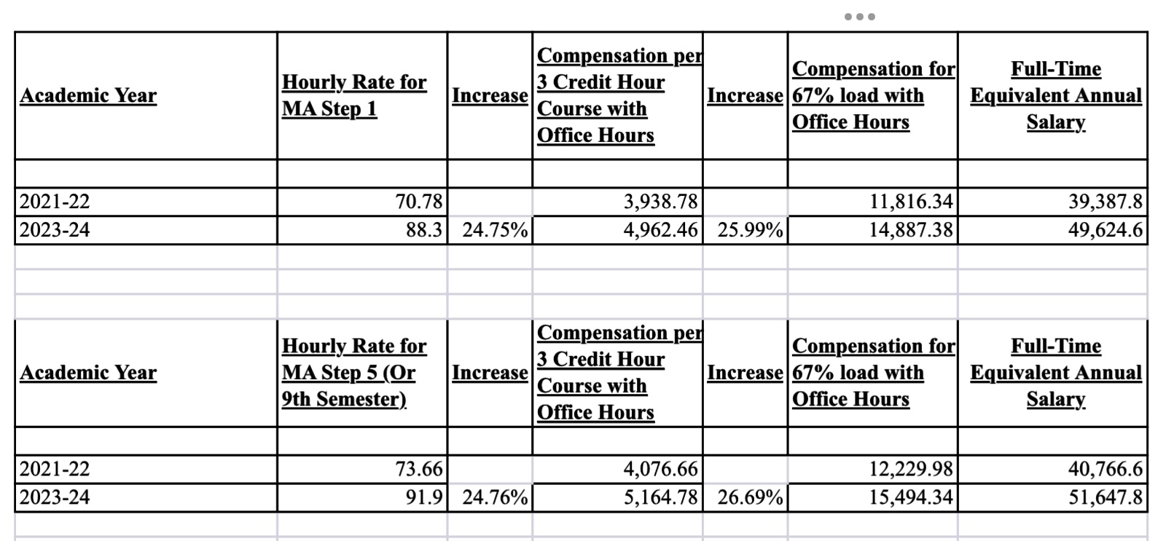

Slide 6
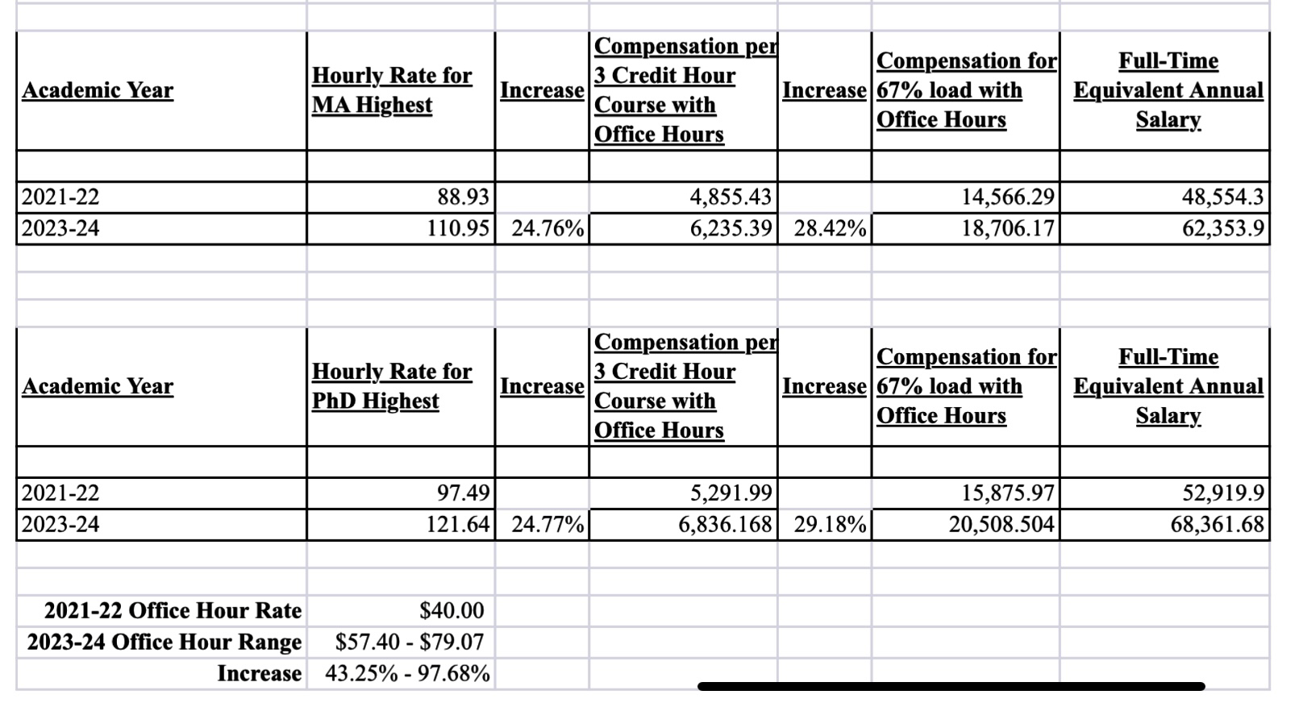

Slide 10
Article 11: Working Conditions (Academic Freedom)
Unit members have the right to select their own instructional materials to be used in their class(es), consistent with the official course outline of record. Exceptions may include situations in which all faculty teaching the given course(s) are required to use department-established laboratory manuals based on established instructional schedules, instructional materials and learning management systems needed to meet requirements from external accreditation and authorizing bodies, required SLO assessment content to be evaluated consistently across the department, and the use of software programs which must be vetted by a department in accordance with college policies and procedures. (Article 11.B.2.)

Slide 11
APPENDIX G: DISTRICT-COMPENSATED COMMITTEES
Increased participation in college governance
Added additional paid committees
Increased number of paid seats on committees

Slide 12
Article 19: Professional Development
ACUE Replaces the Skilled Teachers Course
For ACUE, 1 microcredential course (6-7 modules) = 1 unit. Unit members who successfully complete 3 units will remain at their earned step and will be advanced to range B (without Ph.D., J.D., Ed.D., etc.) or range D (with Ph.D., J.D., Ed.D., etc.) on the salary schedule per Appendix A, effective the following summer session. Alternatively, unit members may receive paid FLEX hours for each hour of ACUE training up to their maximum available FLEX hours that same semester. Unit members cannot use units for movement across the salary schedule if receiving FLEX payment for those same hours.

Slide 13
Academic Expectations MOU
Codifies Existing Policies
Adds a requirement to enter grades into Canvas, even if the instructor is not using a Canvas shell for the course.

Slide 14
Challenges Ahead
Healthcare
Pay Parity
80-85% load

Slide 15
American Federation of Teachers Local 6262
Follow us on:
Twitter: @AFTLocal6262
Facebook Group: AFT Local 6262
Website: www.aftcoc.org

